Slide 1
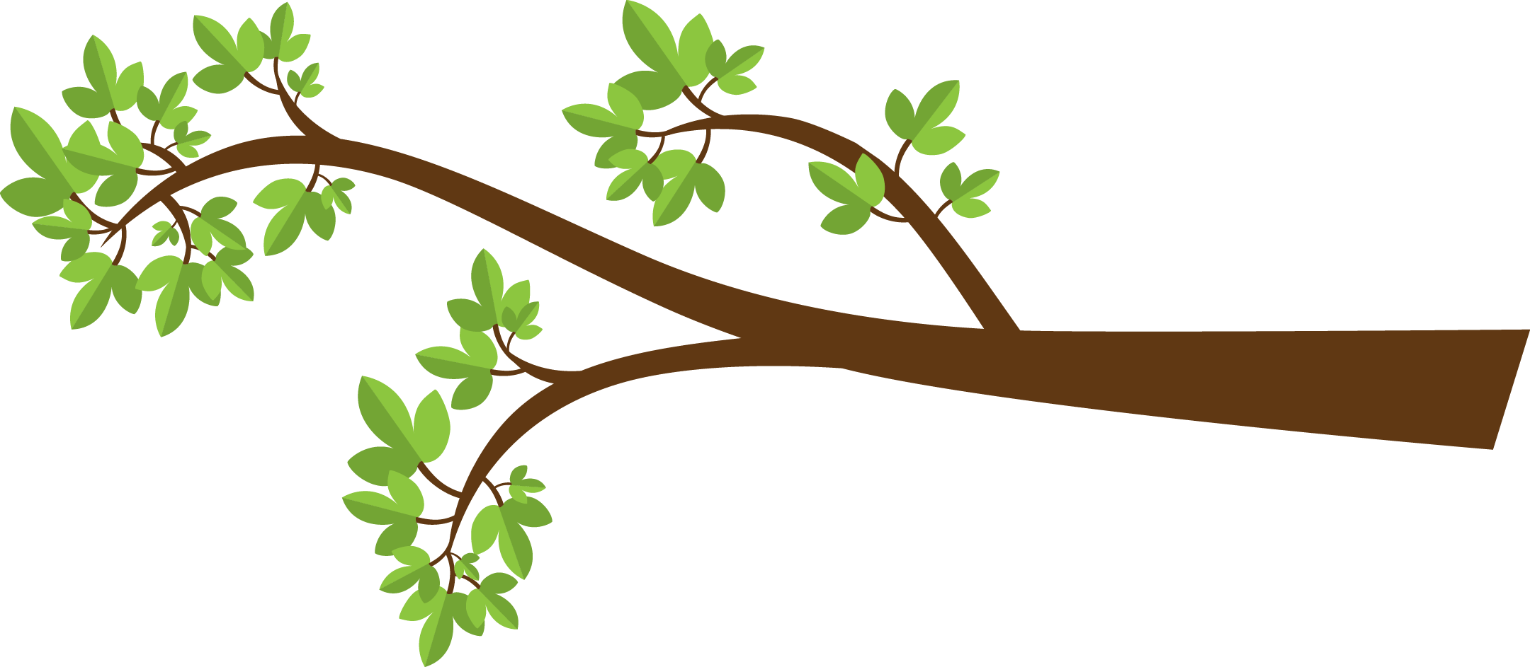
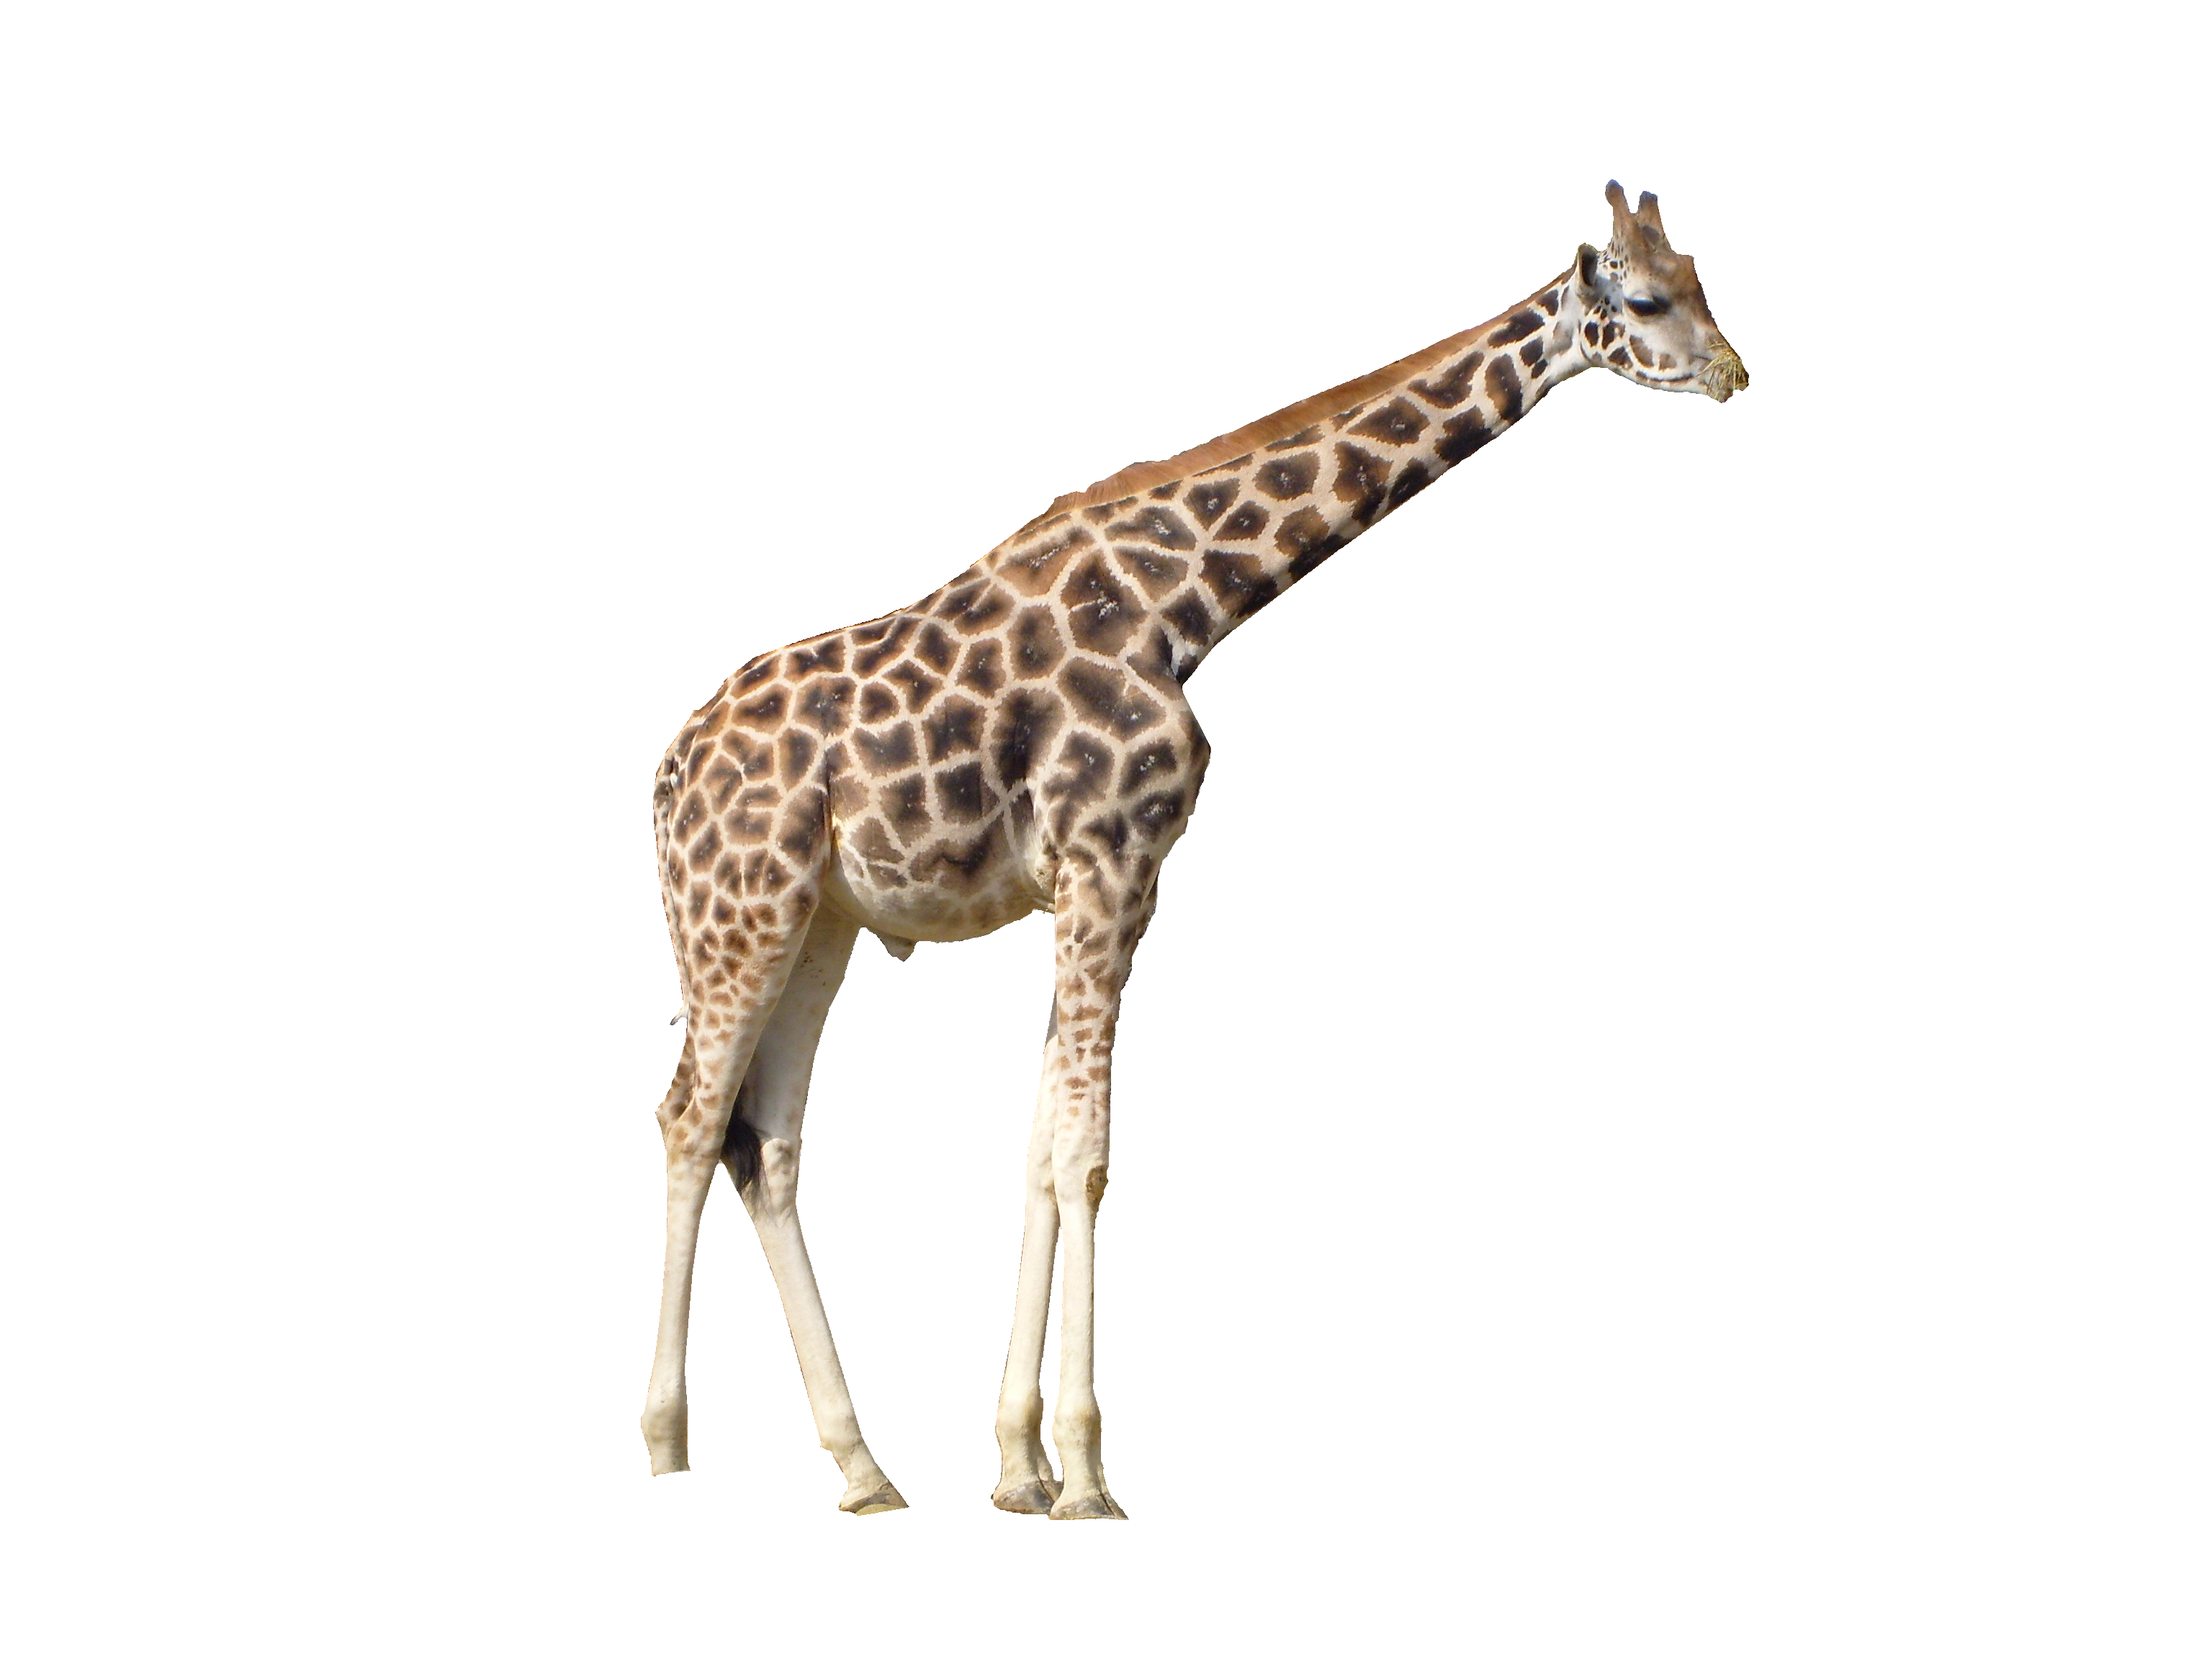


Long neck adaptation – can obtain food from tall trees
“Morality” adaptation – can cooperate with others

Slide 2
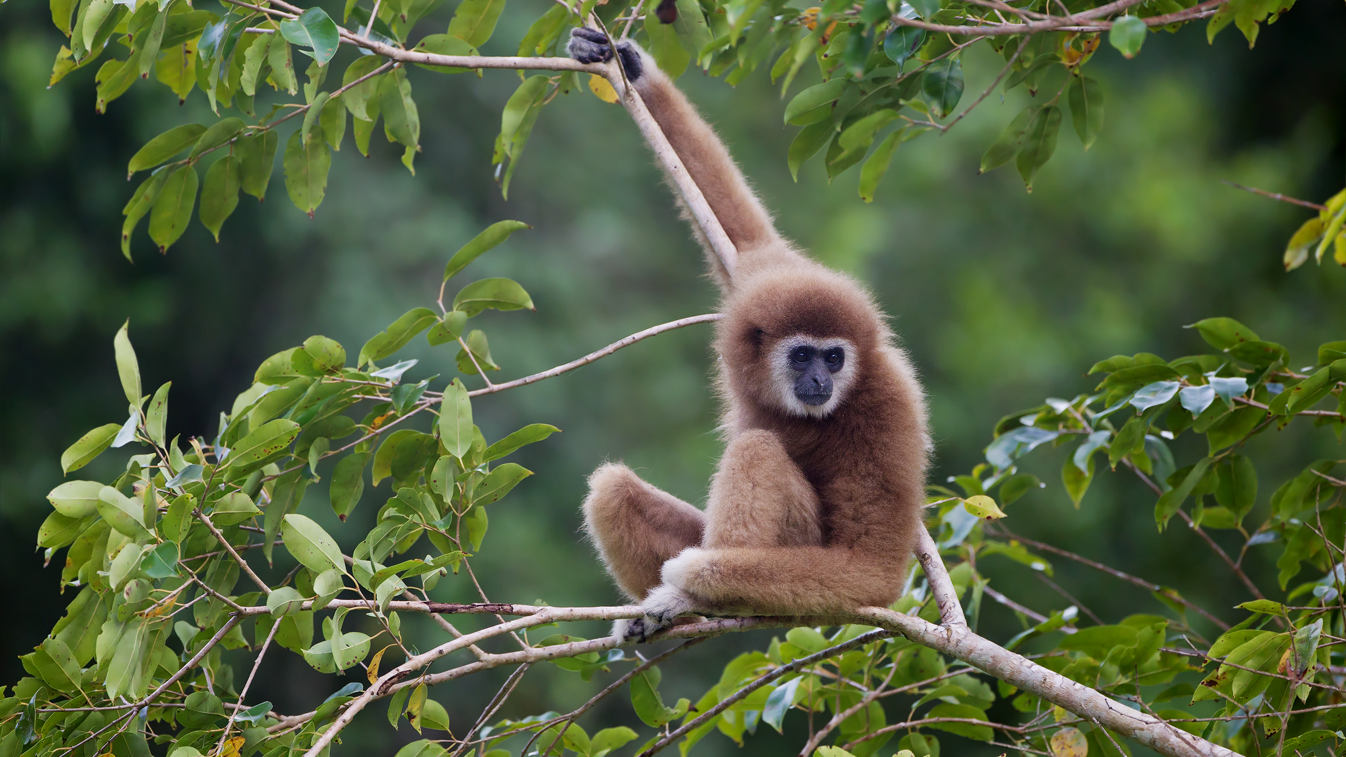
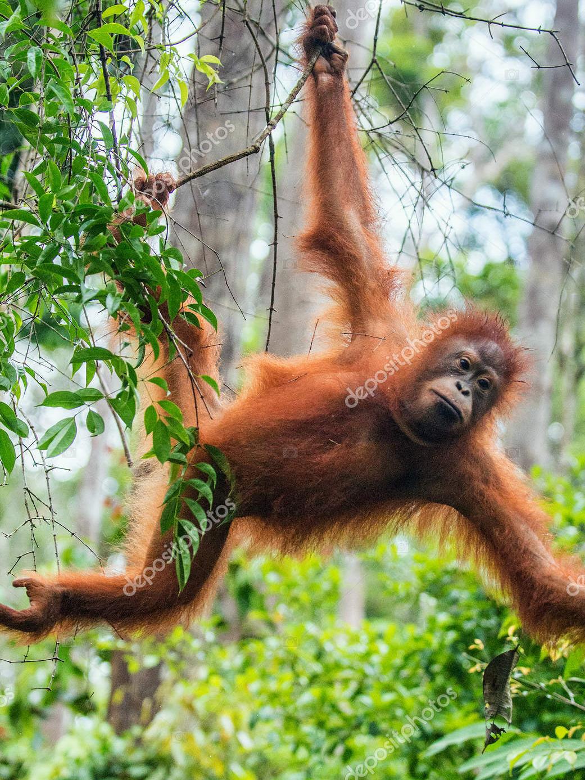
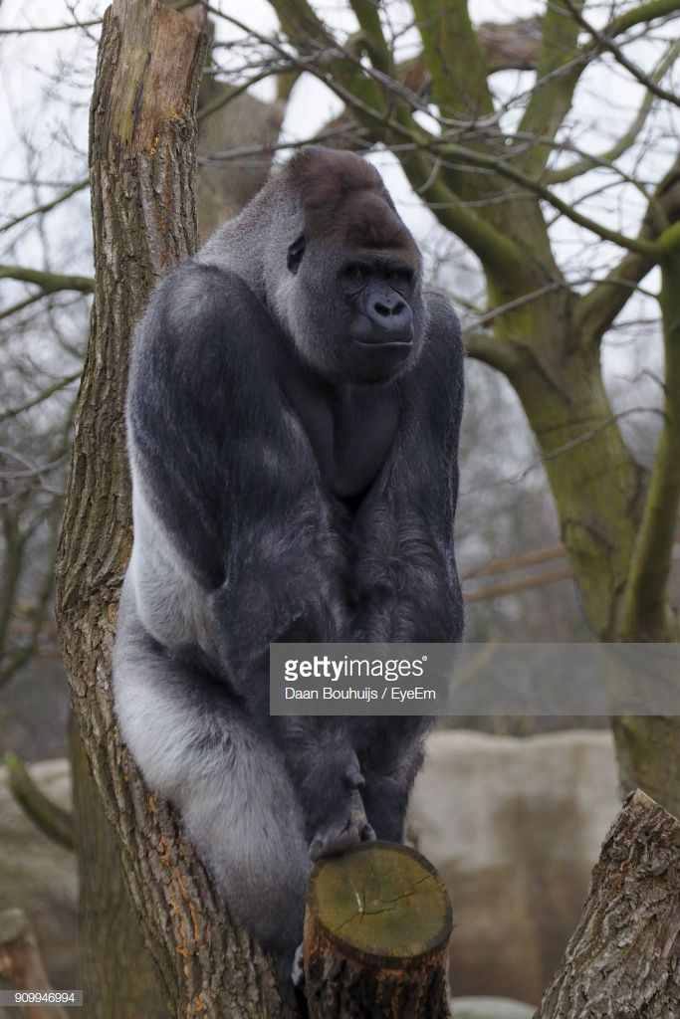
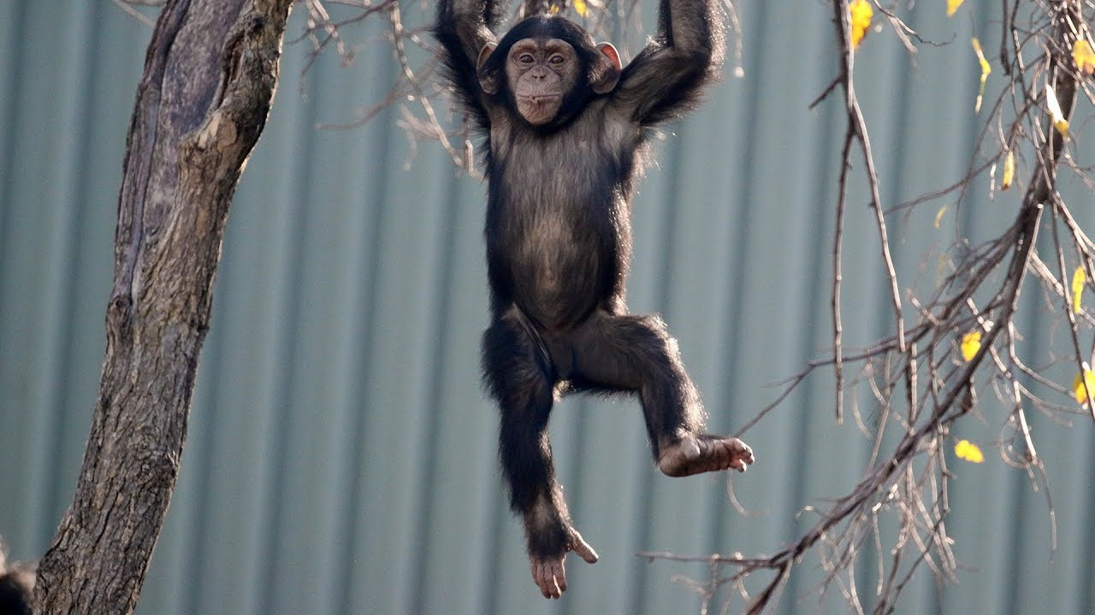
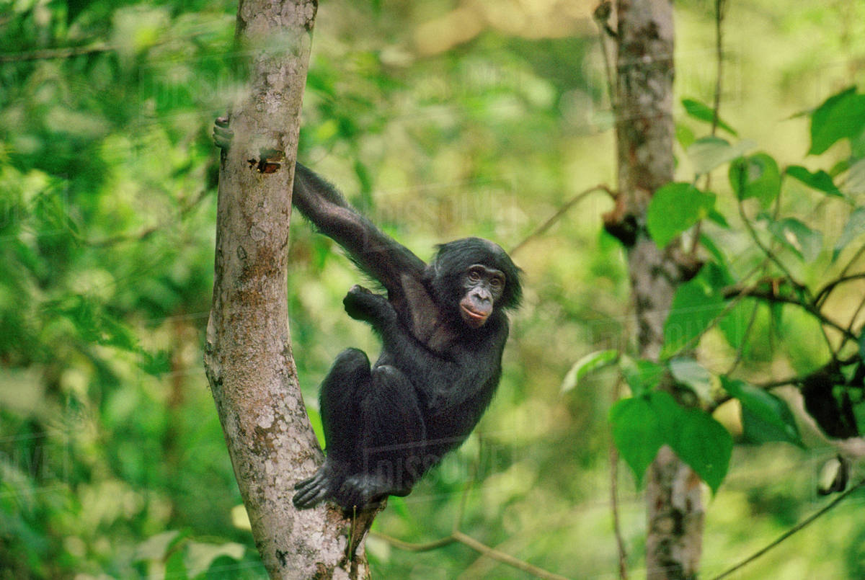
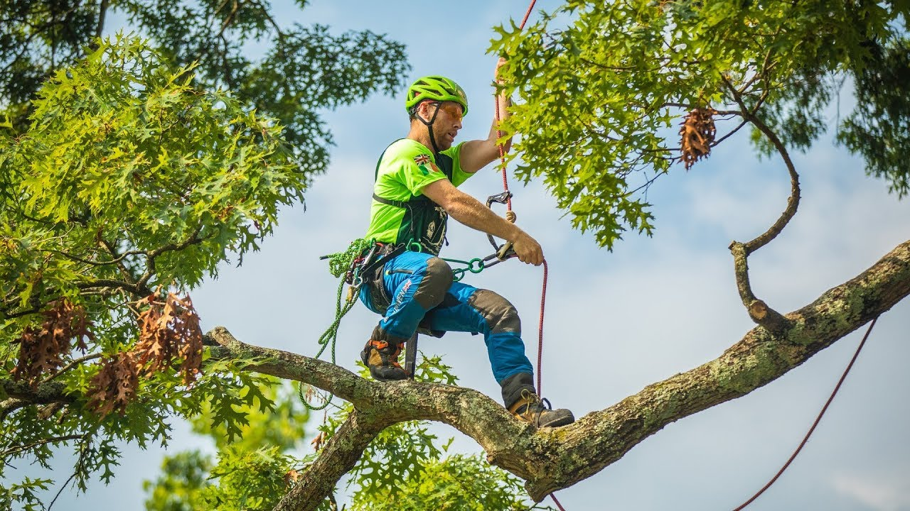

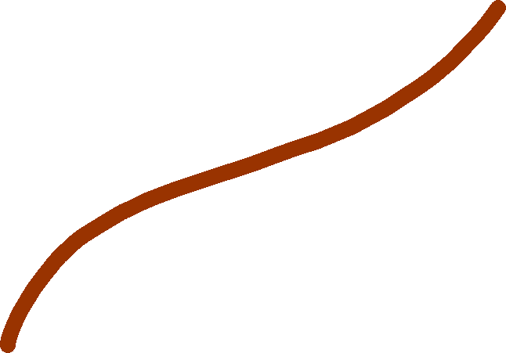



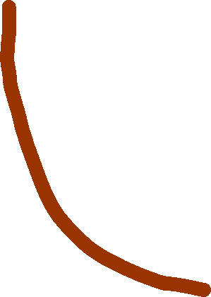

GIBBON
ORANGUTAN
GORILLA
CHIMPANZEE
BONOBO
HUMAN
2.5 million years ago
5-6 million years ago
8-9 million years ago
15 million years ago
22 million years ago

Slide 3


ORANGUTAN
GORILLA
HUMAN
BONOBO
CHIMPANZEE
2 million years ago
4-6 million years ago
6-8 million years ago
12-16 million years ago

